Slide 1
GLEN ROSE ISD
BOND ELECTION 2023

Slide 3
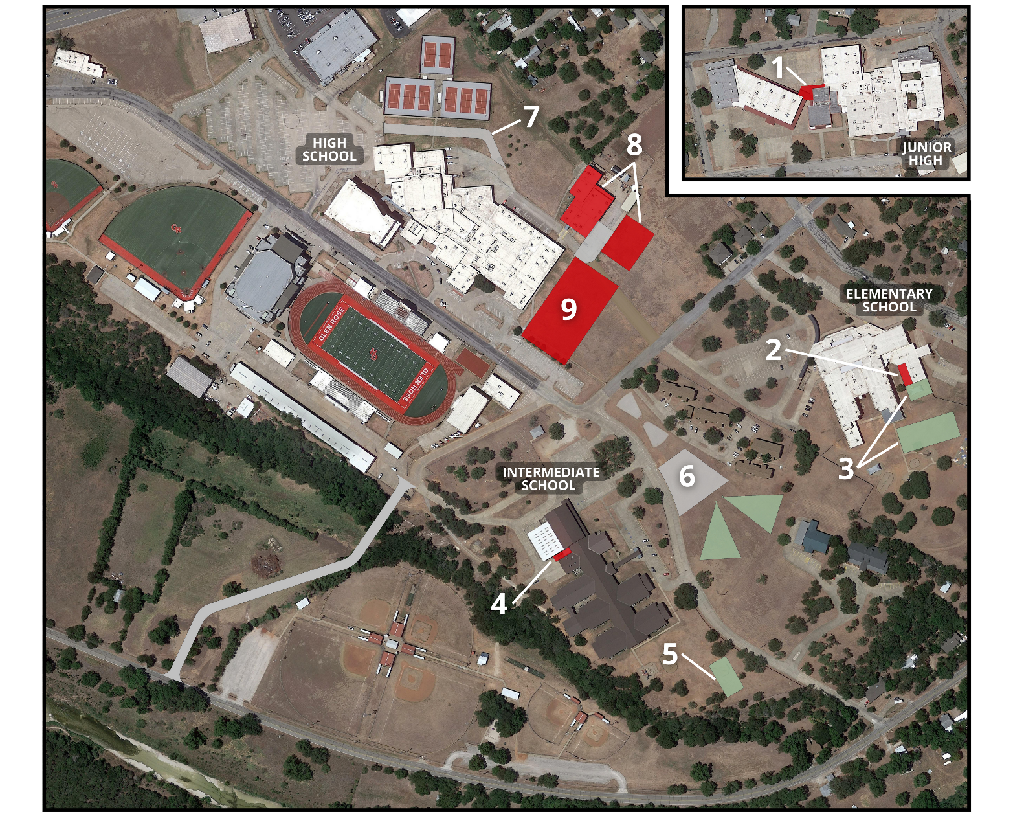
PROPOSED PROJECTS

Slide 4
1 - SECURITY
Connect Junior High gym to main building
2,560 SF | $1,035,471

Slide 5
2 - EXPANSION
Addition of the pre-kindergarten classrooms
2,000 SF | $827,400
3 - IMPROVEMENTS
New playground
$1,000,000

Slide 6
4 - EXPANSION
Expansion for parent pick-up/drop-off
1,200 SF | $450,707
5 - IMPROVEMENTS
New playground
$1,000,000
6 - PROJECT IN CONSIDERATION
New parking lot with relocated discus field
$227,122

Slide 7
7 - IMPROVEMENTS
New roadway connection from North parking lot to rear parking lot
$201,960
8 - EXPANSION
Addition for CTE/Ag Mech and improvements to CTE/Auto Shop
16,000 SF (New)
20,000 SF (Improvements)
| $11,258,035
9 - IMPROVEMENTS
Indoor Multi-Purpose Center
44,500 SF | $6,995,405

Slide 8
DISTRICT WIDE
SECURITY
Keyless entry points – $300,000
PROJECTS IN CONSIDERATION
Cafeteria improvements – $300,000
Restroom improvements – $300,000
Additional seating for tennis, softball, and baseball – $300,000
Additions to exterior lighting – $300,000
Vehicular and equipment improvements for transportation facility – $1,000,000
IMPROVEMENTS
HVAC improvements – $4,000,000
Furniture – $500,000
Equipment for fine arts – $500,000
Ag Farm improvements – $500,000

Slide 10
If there is no tax rate increase, why does the ballot say this?
While there is no tax rate increase, Texas State law requires the phrase "This is a property tax increase" to be on every school bond measure ballot.

